Slide 1
EECS 2500 Linear Data Structures
Lecture 06
Chapter 02 – Abstract Data Types – Part 3
Fall 2016
Dr. Larry G. Thomas – University of Toledo/LCCC

Slide 2
Chapter 2 – Abstract Data Types (ADT)
2.1: Abstraction
2.2: The StringLog ADT Specification
2.3: Array-based StringLog Implementation
2.4: Software Testing (12 pp.)
2.5: Introduction to Linked Lists (12 pp.)
2.6: LL StringLog ADT Implementation (11 pp.)
2.7: Software Design: Identification of Classes (4)
2.8: Case Study: A Trivia Game (17 pp.)

Slide 3
Last Time
Software Testing (§2.4)
Verification and Validation
Testing as a formal process
Designing test cases
Black-box testing
Testing “at the boundaries”
Test drivers – programs to run the individual tests
Regression testing / regression errors

Slide 4
Last Time (2)
Introduction to Linked Lists (§2.5)
Links are nothing more than reference variables
Some (regular) reference variable tells us where to find the first node on the list (if there is one; null if there isn’t one – i.e., the list is empty)
Another reference variable (in the first node) tells us where to find the next node (if there is one…)
Self-referential class
Linked Lists have advantages / disadvantages relative to arrays
Designed and implemented the LLStringNode
Created a linked list of LLStringNodes

Slide 5
Last Time (3)
Operations on linked lists:
Traversing (visiting all nodes on the list)
Inserting (beginning, middle, end)
Deleting (beginning, middle, end)
Traversing a list with a while loop
Inserting a new node at the beginning of the list
We’ll cover inserting in the middle and at the end later
The order in which we set the references is critical
Any questions so far?

Slide 6
The Linked-List StringLog Implementation
Section 2.6

Slide 7
The Linked-List StringLog (§2.6)
In §2.3, we implemented the StringLog using an array
Be clear: a StringLog is not an array; nor is it a linked list
The StringLog isn’t defined by how we implement it, but by what functionality it provides
A car is a car, whether it has a 4-, 6-, 8-, 10-, or 12-cylinder engine, gasoline, diesel, or electric, and a manual or auto transmission (or CVT)
A PC is a PC regardless of the motherboard, CPU, and graphics card installed

Slide 8
The Linked-List StringLog (§2.6)
A StringLog is an ADT (abstract data type) that:
Has a name, stores strings, & provides the operations:
insert, isFull, size, contains, clear, getName, and toString
How we create the StringLog’s functionality doesn’t matter, as long as it does what it is supposed to (provides the required methods – implements the correct interface)
Precisely what is inside the “black box” doesn’t matter
The black box just has to “plug in” and do what it should
Bank teller example (yet again)

Slide 9
The Linked-List StringLog (§2.6)
We call our new StringLog class the LinkedStringLog class, to differentiate it from the array-based class of §2.3.
We also refer to this approach as a reference-based approach.
Like the ArrayStringLog class, our LinkedStringLog class is part of the ch02.stringLogs package.

Slide 10
The Linked-List StringLog (§2.6)
The class fulfills the StringLog specification and implements the StringLogInterface.
The next two slides are taken directly from Chapter 2, Part 1 – this was the interface we used to build the StringLog using an array; this time, we’ll build the same functionality using linked list nodes

Slide 11
The StringLog Interface (1)
//---------------------------------------------------------------------
// StringLogInterface.java by Dale/Joyce/Weems Chapter 2
//
// Interface for a class that implements a log of Strings.
// A log "remembers" the elements placed into it.
//
// A log must have a "name".
//---------------------------------------------------------------------
package ch02.stringLogs;
public interface StringLogInterface
{
void insert(String element);
// Precondition: This StringLog is not full.
//
// Places element into this StringLog.
boolean isFull();
// Returns true if this StringLog is full, otherwise returns false.

Slide 12
The StringLog Interface (2)
int size();
// Returns the number of Strings in this StringLog.
boolean contains(String element);
// Returns true if element is in this StringLog, otherwise returns false.
// Ignores case differences when doing string comparison.
void clear();
// Makes this StringLog empty.
String getName();
// Returns the name of this StringLog.
String toString();
// Returns a nicely formatted string representing this StringLog.
}

Slide 13
The Linked-List StringLog (§2.6)
Unlike the ArrayStringLog, LinkedStringLog will implement an unbounded StringLog.
Since we’re not using arrays, and since Linked Lists can be expanded indefinitely, we’re not limited by the size with which we declare the array
If we wanted to provide a LinkedStringLog that had EXACTLY the same API (programming interface), then we would need to be able to accommodate a constructor with a size value, which we would then just ignore, and call the (only) constructor anyway.

Slide 14
LinkedStringLog - Attributes
Instance variables:
Rather than a String array called log, we’ll have a linked list called log. This will be a linked list of LLStringNodes
We built this linked list in section 2.5
Since we’re not using an array, we don’t need the lastIndex variable at all.
We DO, however, still need a String to hold the log’s name.

Slide 15
LinkedStringLog - Attributes
Attributes ≡ Instance Variables (p. 115)
In the Array-based version:
protected String name; // name of this log
protected String[] log; // array that holds log strings
protected int lastIndex = -1; // index of last string in array
In the Linked List-based version:
protected String name; // name of this log
protected LLStringNode log; // Linked list of strings
// (reference variable pointing to
// first node on list or null)

Slide 16
LinkedStringLog - Constructors
In the Array-based version, we had two (overloaded) constructors:
One to accept only a String (for the StringLog’s name; the maximum size was set to 100), and
One to take a String (for the log’s name) and an int to set the StringLog’s maximum size
In the Linked List-based version, we don’t worry about the size of the log (because we’re not constrained by an array), so we only need one constructor – to accept a name for the StringLog

Slide 17
LinkedStringLog - Constructor
For the Linked List-based version (p. 116):
public LinkedStringLog(String name)
{
// Instantiates and returns a reference to an empty
// StringLog object with the name “name”
//
log = null; // nothing in the list
this.name = name; // save the log name
}

Slide 18
LinkedStringLog - Mutators
Mutator ≡ Transformer – we have two:
public void insert(String element)
{
// Precondition: StringLog is not full
// Postcondition: element is inserted at the front of the StringLog list
//
LLStringNode newNode = new LLStringNode(element);
newNode.setLink(log); // new node points to rest of list
log = newNode; // head of list is the new node
}
public void clear()
{
// makes the StringLog empty
//
log=null; // disconnect all the nodes from the list. The
// disconnected nodes (and strings) become garbage
}

Slide 19
LinkedStringLog - Accessors
Accessors ≡ Observers -- we have five:
boolean isFull()
String getName()
int size() - requires a Traversal
String toString() - requires a Traversal
boolean contains(String element) – requires a Traversal
public boolean isFull()
{
// Returns: true if this log is full; false otherwise
// The linked list never fills up, so it’s always false
//
return false;
}
public String getName()
{
// Returns the name of this StringLog
return name;
}

Slide 20
LinkedStringLog - Accessors
int size()
In the array-based version, the index we maintained to tell us which array location to use for the next insertion told us how many strings were already in the StringLog. With no array, we have no index
Instead, we traverse the linked list. Rather than printing each entry, we increment a counter every time we visit a node
As the book correctly points out, we could maintain an instance variable with the number of nodes currently in the list, and increment that when we do an insert. In that case, size() would not require a traversal; it would just return the counter’s current value
For now, we’ll just do the traversal.

Slide 21
LinkedStringLog - Accessors
public int size()
{
// Returns: the number of strings in the StringLog
//
// We traverse the linked list, and increment a counter
// whenever we visit a node
int count = 0; // our node counter
LLStringNode node; // Points to each node; start at head
node = log; // Start at the head of the list
while (node != null) // As long as there IS a node
{
count++; // count it
node = node.getLink(); // advance to the next node
}
return count; //
}

Slide 22
LinkedStringLog - Accessors
String toString()
This is basically the same as the size() method
Rather than just counting the nodes, we count them (so we can number them in the resulting string) and we append the info attribute from every node to our String.
It’s supposed to return a String that looks like:
Log: Nicknames
1. Slick
2. Junior
3. Bubba

Slide 23
LinkedStringLog - Accessors
public String toString()
{
// Returns a formatted string representing this StringLog
//
// We traverse the linked list, and append the string in each
// node whenever we visit a node
String logString = "Log: " + name + "\n\n";
int count = 0; // count nodes (so we can number 'em)
LLStringNode node; // Points to each node; start at head
node = log; // Start at the head of the list
while (node != null) // As long as there IS a node
{
count++; // Increment node counter
logString = logString + count + ". " + node.getInfo() +"\n";
node = node.getLink(); // advance to the next node
}
return logString;
}

Slide 24
LinkedStringLog - Accessors
boolean contains(String element)
This requires yet another traversal.
We traverse the list, and if element is found in one of the nodes, we return true; otherwise, we return false
Our String comparison is performed case-insensitive

Slide 25
LinkedStringLog - Accessors
public boolean contains(String element)
{
// Returns true if element is found in this StringLog; returns false otherwise.
// String comparisons are performed case-insensitive
LLStringNode node = log; // Points to each node; start at head
while (node != null) // If there IS a node
{
if (element.equalsIgnoreCase(node.getInfo()) // match??
return true; // If match, return true NOW
else
node = node.getLink(); // If not, go to next node
}
// If we found the null at the end of the list, then we couldn’t have found a matching
// string. Return false.
return false;
}
See pp.122 – 124 for ALL of the code for this class

Slide 26
Software Design: Identification of Classes
Section 2.7

Slide 27
Software Design: Identification of Classes (§2.7)
Repeat:
Brainstorm ideas, perhaps using the nouns in the problem statement to help identify potential object classes / attributes (verbs usually hint at methods)
Filter the classes into a set that appears to help solve the problem.
Consider problem scenarios where the classes carry out the activities of the scenario.
Until the set of classes provides an elegant design that successfully supports the collection of scenarios.

Slide 28
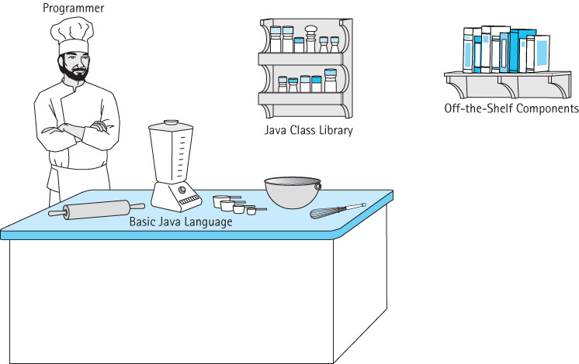
Software Design – Sources for Classes
Cheesy illustration from text:

Slide 29
Software Design – Sources for Classes
Some important library packages:
java.awt (Abstract Windowing Toolkit) - Tools for creating user interfaces, graphics, and images
java.awt.event Provides interfaces and classes for handling the different types of events created by AWT components
java.io System input and output through data streams, serialization, and the file system
java.lang Provides basic classes for use in creating java programs
java.math Provides classes for performing mathematical operations
java.text Provides classes and interfaces for handling text, dates, numbers, and messages
java.util Contains the collections framework, legacy collection classes event model, date and time facilities, internationalization, and miscellaneous utility classes (a string tokenizer, a random number generator, and a bit array)
java.util.jar Provides classes for reading and writing the JAR (Java ARchive) file format, which is based on the standard ZIP file format

Slide 30
Software Design – Sources for Classes
The System Class – To obtain current system properties
The Random Class – to generate a list of random numbers
The DecimalFormat Class – to format numbers for output
Wrappers – to wrap a primitive valued variable in an object’s structure
The Throwable and Exception Classes – An exception is associated with an unusual, often unpredictable event, detectable by software or hardware, that requires special processing.

Slide 31
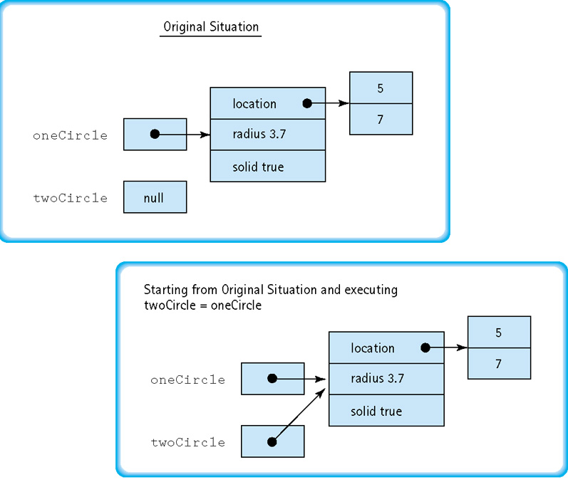
A Bit More on Aliasing / Reference Variables
We’ve already talked about aliasing and how two reference variables can refer to (i.e., point at) the same instance of a class (object).
As our designs (and our ADT’s) get increasingly complex, we can run into a new problem…

Slide 32
A Bit More on Aliasing / Reference Variables
If we didn’t want to alias the two (i.e., if we really wanted a copy of the object), there can be (depending on the object) two possibilities:
Shallow copy and Deep copy
Suppose the object we want to copy has reference variables in IT.
Example: The Circle class (previous slide) has a location (for the circle’s center), a radius, and whether it is solid or not.
If the location of the circle’s center is implemented as a “coordinates” class, then the center will actually be a reference to some other object:

Slide 33
A Bit More on Aliasing / Reference Variables
Illustration from previous example.
Note that the circle object contains a reference to yet another object – coordinates for the center of the circle (5,7)

Slide 34
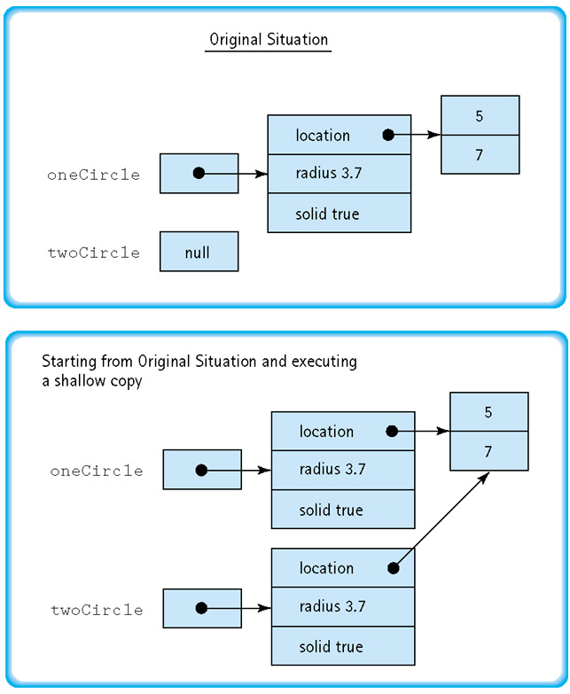
A Bit More on Aliasing / Reference Variables
A shallow copy copies just the circle object itself
The two circle references (oneCircle and twoCircle) now refer to distinct circle objects, but both objects refer to the same center coordinate (5,7)

Slide 35
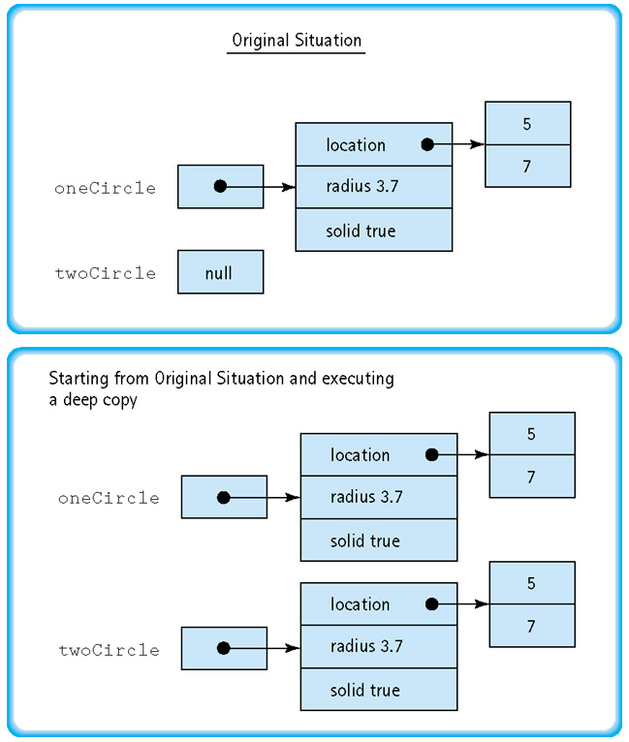
A Bit More on Aliasing / Reference Variables
A deep copy copies the circle object itself, and any objects to which it has references are also copied
Now two circle references (oneCircle and twoCircle) are completely independent

Slide 36
Case Study: Trivia Game
Section 2.8

Slide 37
Case Study: Trivia Game (§2.8)
This section is pretty straightforward, and provides a good start-to- finish walk-through of the design of a non-trivial (pun intended) application
You should check out this code, walk through it, run it, and generally understand it.
Don’t just glance at it – study it, and make sure you really get what it does.
If you have problems, let me know.

Slide 38
ADT Summary
ADTs are Abstract Data Types
They provide implementation-independent “black boxes” to get things done. We can implement the functionality inside that “black box” any way we like.
The ADT has only to provide the services the outside world expects of it; HOW it does so is up to the programmer (though some solutions will be better in some cases than others)
We examined the Linked List ADT, & introduced the traversal and insert (at the head) functions

Slide 39
Designing ADTs
Some guidelines:
1. Determine the needed ADT’s general purpose.
2. List the specific types of operations the application program performs.
3. Identify a set of public methods to be provided by the ADT class that allow the application program to perform the desired operations.
4. Identify other public methods which help make the ADT generally usable.
6. Decide how to structure the data.
7. Decide on a protection level for the identified data.
8. Identify private structures and methods.
9. Implement the ADT.
10. Create a test driver and test your ADT.

Slide 40
? Questions ?
? Questions ?
Notes:
40

